Slide 1
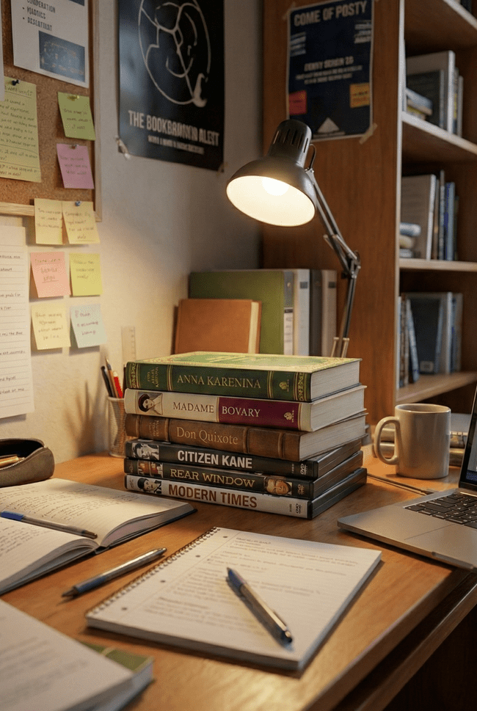
Personal Library Management System (PLMS)
A Comprehensive Solution for Organizing Book and DVD Collections

Slide 2





Current Situation: Disorganization and Challenges
Memory and Scattered Notes
Inconsistent Data Entry
Poor Searchability
Users often entrust their collections to their memory, spreadsheets, or scattered notes.
Metadata inconsistencies and duplicate entries make collection management difficult.
Lack of searchability makes finding a specific item impossible.
Untracked Loans
No Reading Progress
Books and DVDs borrowed and forgotten are a common problem.
Not keeping track of reading or viewing progress reduces motivation.

Slide 3


Solution: An Organized Library with PLMS
PLMS is an application designed to organize your personal book and DVD collection. It transforms disorganized collections into a structured, easy-to-manage digital library.
Reduce Manual Effort
Improved Discoverability
Minimizes manual data entry through automation.
Easily find items with comprehensive search and filtering features.
Centralized Data Management
Consolidate all your library data in one central location.
Offers multi-device access with optional cloud synchronization.

Slide 4





Key Features: Your Collection at Your Fingertips
Smart Inventory
Search and Filtering
Lists and Organization
Fast item addition via ISBN/Barcode scanning (via Google Books, OMDb APIs).
Advanced filtering options such as genre, author, tag, year, and lending status.
Create custom lists (e.g., "Summer Reads") and reorder items.
Progress Tracking
Lending Management
Record pages read or minutes watched; visualize completion percentage.
Track who you've lent to, set due dates, and receive overdue reminders.

Slide 5
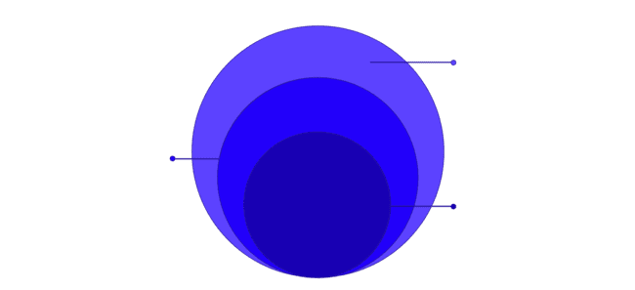
System Architecture: Layered and Modular Structure
PLMS uses a layered, three-tier architecture to provide robustness and flexibility.
Data Persistence
Database, storage, and backup
Application Logic
Business rules, services, and APIs
Presentation Layer
User interface and input/output

Slide 6






Architecture Depth: Subsystem Decomposition
The system is divided into modular subsystems, which facilitates maintenance and future expansion.
Inventory
Manages book and DVD records.
External Integration
Communicates with external APIs like Google Books and OMDb.
Lists
Manages user-defined collection lists.
Progress
Tracks reading and watching progress.
Loans
Manages lending and borrowing processes.
Data I/O
Manages data persistence (relational database).

Slide 7





Data Flow: From Requests to Persistence
Ensuring a seamless flow from user interactions to data storage.
Client Request
The user initiates an action via the web interface.
Controller Processing
The request is received and routed by the controllers.
Service Logic
Business logic and external integration are handled by services.
Database Persistence
Data is securely stored in a relational database.

Slide 8

Design Goals: User-Centric Experience
The core design principles of PLMS are to provide a superior user experience.
1
Usability
A user-friendly interface with the goal of completing the "Add with ISBN" feature in less than 3 steps and providing clear feedback.
2
Performance
Guaranteeing fast response times by delivering search results for a collection of 5,000 items in under 1.5 seconds.
3
Reliability
Preventing data loss and ensuring the system continues to operate smoothly even when external APIs fail.

Slide 9

Lessons Learned
Automation Drives User Adoption
Manual data entry is a significant barrier for users; integrating ISBN and barcode scanning via Google Books and OMDb APIs is essential for a seamless experience.
Modular Design Facilitates Scalability
A three-tier architecture—separating the presentation layer, application logic, and data persistence—is vital for building a robust and maintainable system.
Searchability is a Core Requirement
To avoid the chaos of a physical collection, developers must implement advanced filtering for attributes like genre, author, and lending status.
Performance Metrics Must be Quantifiable
Establishing concrete targets, such as search results for 5,000 items in under 1.5 seconds, provides clear benchmarks for backend optimization.

Slide 10

What Should Be Done Better
Increase Platform Versatility
Transitioning from a purely web-based interface to dedicated mobile and desktop applications would offer users superior accessibility.
Integrate Social and Analytical Tools
Features like social sharing and reading habit reports would significantly enhance user engagement.
Diversify Selection Methods for Lists
Rather than relying strictly on unique IDs (ISBN/OMDb ID), allow users to add items to custom lists using titles, author names, or custom tags for a more intuitive workflow.
Implement NLP-Based Recommendations
Use Natural Language Processing to analyze user metadata and reading/viewing progress to suggest new content.

Slide 11

What Should Never Be Done
Never Rely on Volatile Storage
Relying on memory or scattered notes leads to data loss; all library information must be stored in a secure, relational database.
Avoid Mandatory Manual Entry
Forcing users to type metadata leads to inconsistent data and duplicates; always prioritize automated fetching.
Never Neglect Loan Tracking
Untracked loans are a primary pain point; a system must always include a dedicated mechanism for tracking borrowers and due dates.
Avoid Monolithic Architecture
Do not bundle all features into a single codebase; a modular "subsystem decomposition" is necessary to prevent the system from becoming unmanageable.

Slide 12
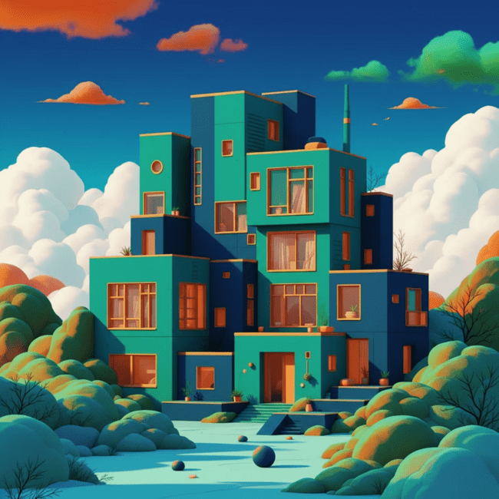
Future Scope and Conclusion
Forward-Looking Design
The PLMS is designed to be technology-agnostic and modular, creating a robust foundation for future expansions.
New Features: Features such as tagging, reporting, and social sharing integrations can be added based on user requests.
Platform Support: Potential for expansion to different platforms such as mobile applications and desktop clients.
API Development: Providing an API for integration with other applications.
The PLMS transforms a complex personal library into a structured, easy-to-manage, and enjoyable digital collection.

Slide 13

Team Contributions
Student Name | RAD | SDD | Implementation
Yiğit Doğan Aladağ | 25 | 25 | 30
Ömer Fehmi Çakıcı | 25 | 25 | 30
Muhammet Furkan Yılgın | 25 | 25 | 20
Yusuf Aslanargun | 25 | 25 | 20

Slide 14



Digitize Your Collection with PLMS
Thank You For Listening

